Slide 1
CS168: Final Review
Intro to the Internet
Spring 2024

Slide 2
Agenda
Topical Review [~1 hour]
Final Exam Practice Questions [~50 minutes]
Disclaimer: this review session is not comprehensive
Overview will only cover topics starting from Datacenters
All pre-Datacenters topics are covered in the Midterm Review
“Lectures 1-25, discussions 1-13, and all projects are in scope” - Ed

Slide 3
Datacenters

Slide 4
Datacenters
How does one design datacenter networks?
Consider new assumptions (i.e., different from what we learned in Internet).
Single administrative control over the network topology, traffic, and to some degree end hosts
Much more homogenous
Strong emphasis on performance
Few backwards compatibility requirements, clean-slate solutions welcome!

Slide 5
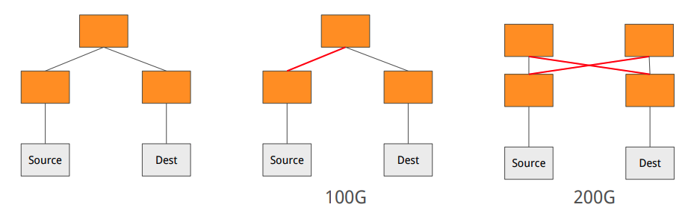
Bisection Bandwidth
We want a network with high bisection bandwidth:
Pick the number of links we must cut in order to partition a network into two halves
Bisection bandwidth is the sum of those bandwidths.

Slide 6
Bisection Bandwidth
Full bisection bandwidth: Nodes in one partition can communicate simultaneously with nodes in the other partition at full rate.
Given N nodes, each with access link capacity R, bisection bandwidth = N/2 x R
Oversubscription, informally, how far from the full bisection bandwidth we are
Formally: ratio of worst-case achievable bandwidth to full bisection bandwidth.

Slide 7
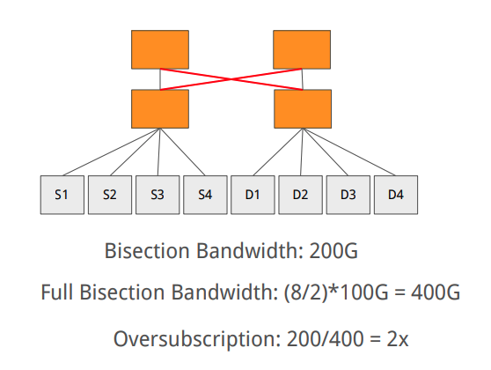
Bisection Bandwidth

Slide 8
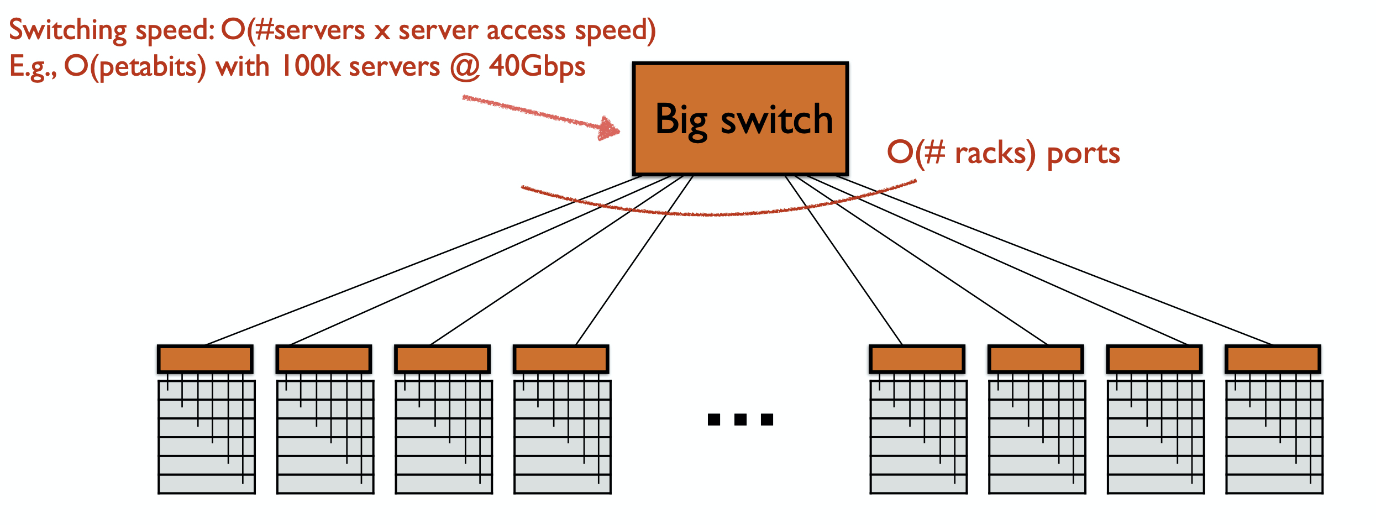
Big switch abstraction
We want an abstraction of big switch;
Naive solutions:
Server-to-server full-mesh;
A physical big switch?
Either impractical or too costly ($$$); 10k hosts * 10k hosts = ~100M links
Can we do better?
Notes:
Let’s just cover the clos based topology for now.

Slide 9
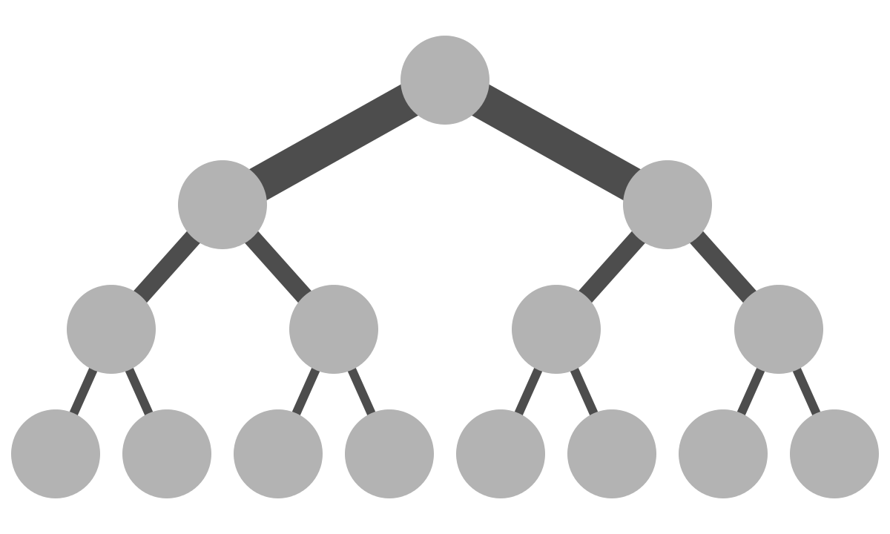
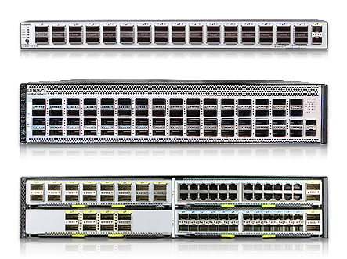
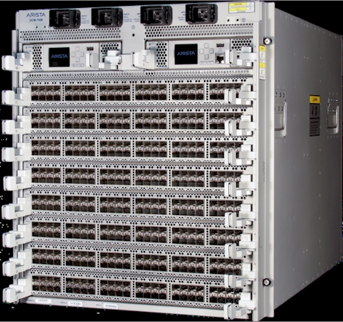
Design 1: Fat tree (scale-up)
Borrowed straight from the High Performance Computing (i.e., supercomputers) community
Use of big, non-commodity switches
Problem? Scales badly in terms of cost
..only a few switch vendors can make big switches
Scales badly in terms of fault-tolerance
small switch
big switch
Notes:
Fat tree has less (in amount) but more powerful components (links and switches) in the topology. When one components fails it has much higher impact on the remaining bandwidth than if one component were to fail in clos topology.

Slide 10
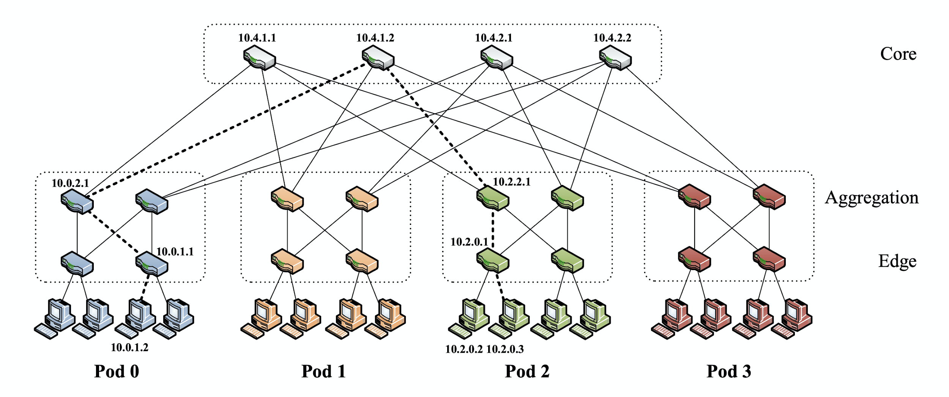
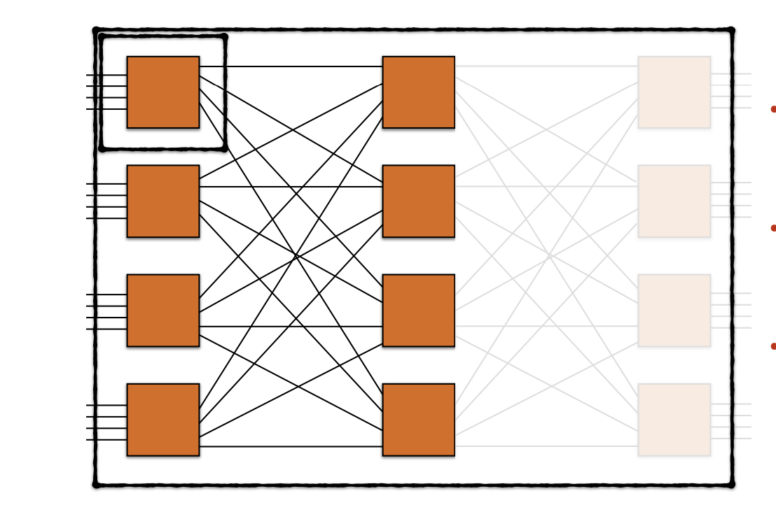
Design 2: Clos (scale-out)
Replace nodes in the fat tree with groups of cheap commodity switches
cheaper
high redundancy (bisection width)
Allows oversubscription ratio of 1

Slide 11
A Closer look at Clos
The concept of redundancy and the clos topology itself have many variations!
We focus on the 3-tiered clos topology
Homogenous switches (k ports) and links
Each non-core switch has k/2 ports pointing north and k/2 pointing south

Slide 12
ECMP
ECMP - Equal Cost Multi-Path
Goal: use multiple paths in network topology that are equal cost
Idea: Load-balance packets across different forwarding paths
ECMP Hash Function:
f(src_ip, dst_ip, proto, src_port, dst_port)
“Per-flow” load balancing

Slide 13
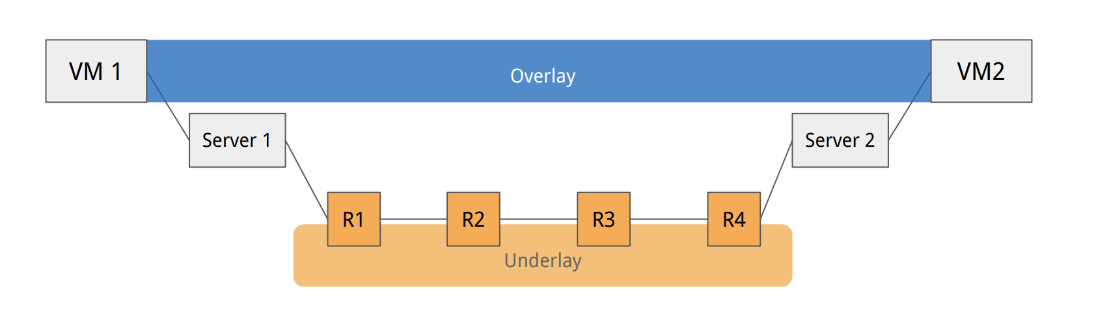
(Over/Under)lay
With VMs, many hosts spin up frequently
Addressing could become a mess!
And won’t scale!
Thus, we build overlay networks

Slide 14
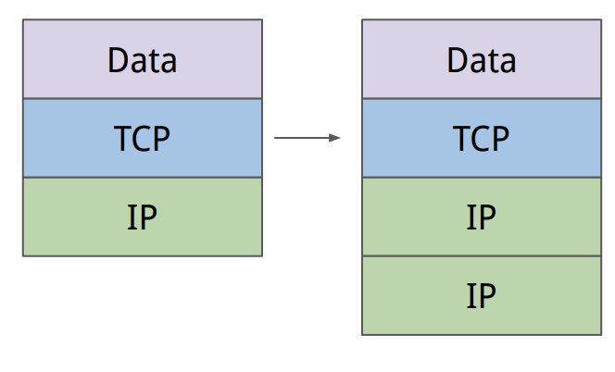
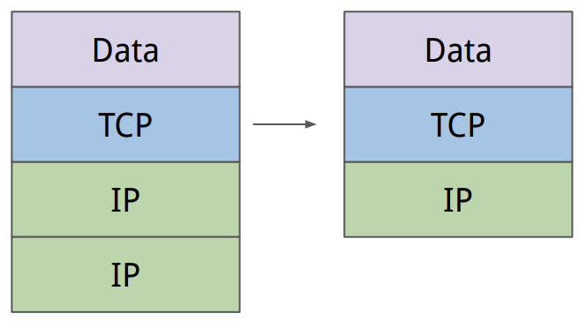
How? Encapsulation
Encapsulation: put another header on the packet
Decapsulation: remove extra headers that were added for encapsulation

Slide 15
SDN

Slide 16
What is SDN?
A way to manage networks through a logically centralized controller
What is management?
Generally, setting configuration for different protocols
So this can look like many different things!
Examples:
setting routing protocol configuration
setting routes directly
creating tunnels (encapsulation / decapsulation)

Slide 17
How SDN?
In a lot of the cases, implement an overlay network on top of an underlay network
Specifics will vary → that’s part of the appeal (customization)!
What is an overlay?
A subset of the nodes in the underlay network connected together using the destination-based connectivity achieved in the underlay network

Slide 18
How SDN? - Network Virtualization
Fix scalability problems of routing with multitenancy by creating virtual overlay networks
VM3
S3
VM1
VM2
R5
S1
S2
R1
R2
R3
R4

Slide 19
How SDN? - Network Virtualization
Fix scalability problems of routing with multitenancy by creating virtual overlay networks
Overlay Network
VM3
S3
VM1
VM2
Underlay Network
R5
S1
S2
R1
R2
R3
R4

Slide 20
How SDN? - Network Virtualization
Fix scalability problems of routing with multitenancy by creating virtual overlay networks
Overlay Network
VM3
src: VM1 dst: VM3
S3
VM1
VM2
Underlay Network
R5
S1
S2
R1
R2
R3
R4

Slide 21
How SDN? - Network Virtualization
Fix scalability problems of routing with multitenancy by creating virtual overlay networks
Overlay Network
VM3
src: VM1 dst: VM3
S3
VM1
VM2
Underlay Network
R5
S1
S2
src: VM1 dst: VM3
R1
R2
R3
R4
src: S1 dst: S3

Slide 22
How SDN? - Network Virtualization
Fix scalability problems of routing with multitenancy by creating virtual overlay networks
Overlay Network
VM3
src: VM1 dst: VM3
src: VM1 dst: VM3
S3
VM1
VM2
Underlay Network
R5
S1
S2
src: VM1 dst: VM3
R1
R2
R3
R4
src: S1 dst: S3

Slide 23
How SDN?
Where did all this configuration to set up these overlays/underlays come from?
The SDN controller
Controller
VM3
S3
Encap/Decap rules
VM1
VM2
R5
S1
S2
R1
R2
R3
R4

Slide 24
How SDN? - Traffic Engineering
Use labels in header to customize the path that traffic takes
But the existing network only does destination-based forwarding!
Exploit that to create new paths
30G
R5
R6
Cost 10
DC 1
R4
DC 2
R1
Cost 10
Cost 1
10G
R2
R3

Slide 25
How SDN? - Traffic Engineering
Overlay Network
R5-R6
R5-R2-R3
DC 1
DC 2
R2-R5-R6
R2-R3
30G
R5
R6
Cost 10
DC 1
R4
DC 2
R1
Cost 10
Cost 1
10G
Underlay Network
R2
R3

Slide 26
How SDN? - Traffic Engineering
Overlay Network
R5
R6
DC 1
DC 2
R2
R3
30G
R5
R6
Cost 10
DC 1
R4
DC 2
R1
Cost 10
Cost 1
10G
Underlay Network
R2
R3

Slide 27
How SDN? - Traffic Engineering
Overlay Network
R5
R6
DC 1
DC 2
R2
R3
src: H_{DC1} dst: H_{DC2}
30G
R5
R6
Cost 10
DC 1
R4
DC 2
R1
Cost 10
Cost 1
10G
Underlay Network
R2
R3

Slide 28
How SDN? - Traffic Engineering
src: H_{DC1} dst: H_{DC2}
label: R6
Overlay Network
R5
R6
DC 1
DC 2
R2
R3
src: H_{DC1} dst: H_{DC2}
30G
R5
R6
Cost 10
DC 1
R4
DC 2
R1
Cost 10
Cost 1
10G
Underlay Network
R2
R3

Slide 29
How SDN? - Traffic Engineering
src: H_{DC1} dst: H_{DC2}
label: R6
Overlay Network
R5
R6
src: H_{DC1} dst: H_{DC2}
DC 1
DC 2
R2
R3
src: H_{DC1} dst: H_{DC2}
30G
R5
R6
Cost 10
DC 1
R4
DC 2
R1
Cost 10
Cost 1
10G
Underlay Network
R2
R3

Slide 30
How SDN? - Forwarding
Directly program forwarding rules into routers instead of using routing protocols
Requires out-of-band connection with the controller

Slide 31
How SDN? - Forwarding
Link state
Controller
...
H3
R5
H1
H2
R1
R2
R3
R4

Slide 32
How SDN? - Forwarding
Controller
Forwarding rules
H3
...
R5
H1
H2
R1
R2
R3
R4

Slide 33
DNS, Web

Slide 34
Typical DNS Query
root servers
Where is www.wikipedia.org?
Ask .org server at 1.2.3.4
Where is www.wikipedia.org?
Resolving server
.org servers
Ask wikipedia.org server at 5.6.7.8
Where is www.wikipedia.org?
Where is www.wikipedia.org? (recursive)
.wikipedia.org servers
Client
Answer: 9.10.11.12
Notes:
DNS client requests www.google.com

Slide 35
Caching DNS Responses
DNS server
(mydns.berkeley.edu)
DNS responses cached in DNS servers
Expire after TTL (time-to-live)
Most popular sites visited often
Top sites frequently cached. Fast!
www.google.com
IP: Z
DNS client (me.cs.berkeley.edu)
Hostname | IP | TTL
www.google.com | Z | 60 min

Slide 36
Anatomy of a URL
scheme://host[:port]/path/resource
Scheme | Usually a protocol like (http, ftp, https, smtp, rtsp, etc.)
host | DNS hostname or an IP address
port | Defaults to protocol’s standard port e.g. http: 80 https: 443
path | Traditionally reflects the file system
resource | Identifies the desired resource Can also extend to program executions: http://us.f413.mail.yahoo.com/ym/ShowLetter?box=%40B%40Bulk&MsgId=2604_1744106_29699_1123_1261_0_28917_3552_1289957100&Search=&Nhead=f&YY=31454&order=down&sort=date&pos=0&view=a&head=b

Slide 37
HTTP
Client-server architecture
Server is “always on” and “well known”
Clients initiate contact to server
Synchronous request/reply protocol
“Synchronous” means same HTTP session used for request and reply
Runs over TCP, Port 80

Slide 38
Requests and Responses
Request
GET /somedir/page.html HTTP/1.1
Host: www.someschool.edu
User-agent: Mozilla/4.0
Connection: close
Accept-language: fr
(blank line)
Response
HTTP/1.1 200 OK
Connection close
Date: Thu, 06 Aug 2006 12:00:15 GMT
Server: Apache/1.3.0 (Unix)
Last-Modified: Mon, 22 Jun 2006 ...
Content-Length: 6821
Content-Type: text/html
(blank line)
data data data data data ...
Notes:
Request:
Request line: method, resource, and protocol version
Request headers: provide information or modify request
Body: optional data (e.g., to “POST” data to the server)
Reponse:
Status line: protocol version, status code, status phrase
Response headers: provide information
Body: optional data

Slide 39
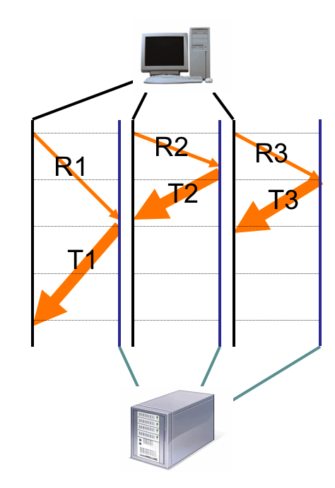
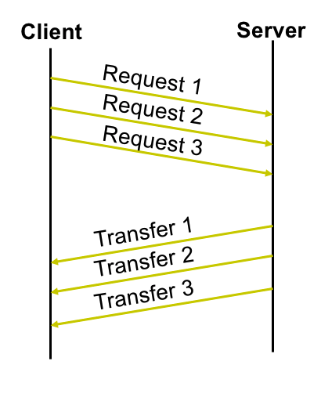
Request Patterns
Concurrent
Pipelined
Persistent
SYN
SYN + ACK
ACK + R1
T1
ACK
R2
T2
Notes:
Concurrent:
Great, but makes the network sad ☹
Persistent:
Performance advantages:
Avoid overhead of connection set-up and tear-down
Allow TCP to learn more accurate RTT estimate
Allow TCP congestion window to increase
i.e., leverage previously discovered bandwidth
Pipelined:
Batch requests and responses to reduce the number of packets. Multiple requests can be contained in one TCP segment

Slide 40
Caching: How
Idea: Replication
Replicate the content across multiple copies to reduce bottlenecks
Implementation: content distribution networks (CDNs)
The client content provider modifies its content so that embedded URLs reference the new domains.
“Akamaize” content
e.g.: http://www.netflix.com/tiger_king.jpg might become http://a1386.g.akamai.net/tiger_king.jpg
Notes:
Next slide is CNAMEs

Slide 41
Caching: CNAMEs
Instead of using a weird URL, use CNAMEs!
List picture as http://cdn.netflix.com/tiger_king.jpg
The authoritative server for this is controlled by netflix
CNAME record aliases cdn.netflix.com to a1386.g.akamai.net
Akamai handles sending to the closest server because a1386.g.akamai.net is under an Akamai nameserver
Only change to the HTML is http://www.netflix.com/tiger_king.jpg became http://cdn.netflix.com/tiger_king.jpg
Notes:
Minor sidenote: Most of Netflix’s large data content is cached on their own CDN

Slide 42
Caching: Specifics in HTTP
GET Request header:
If-Modified-Since – returns “not modified” if resource not modified since specified time
Cache-Control: no-cache – ignore all caches; always get resource directly from server (think force refresh)
Response header:
Cache-Control: max-age=<ttl> – TTL: how long to cache the resource
Cache-Control: no-store – Don’t cache this
When making request, if within the TTL, just load cached resource… otherwise, send with if-modified.
Server will either send a HTTP 304 (“Not Modified”) or HTTP 200 (changed, and here’s the new data)

Slide 43
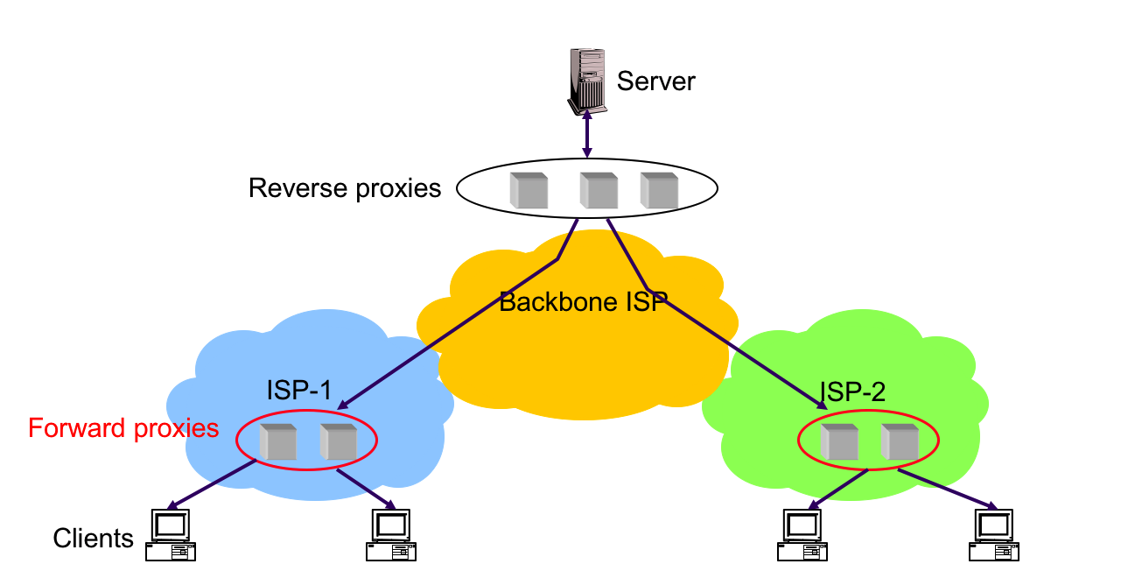
Caching: Where
Forward Proxies
Cache near the client
Reverse proxies
Reduce server load
Notes:
Forward -- think ‘forward deployed’
Reverse -- the reason is usually to reduce the load on the server (hence reverse because it is mainly to help the server, not the client)

Slide 44
DHCP, ARP

Slide 45

DHCP
Enables a host to learn about its….
Own IP Address
Network Mask
First-hop router’s IP Address
DNS Server(s) IP Address(es)
?
?
?
?
INTERNET
?
?
?

Slide 46

DHCP Discovery
DHCP server(s) located on same local network as host
Host initially broadcasts discover message
DHCP Server
IP Address: ???
Subnet Mask: ???
First-hop Router IP Address: ???
DNS IP Address: ???
Local Network

Slide 47
DHCP Offer
DHCP server(s) responds by broadcasting offer message
Message includes assigned IP address, network mask, first-hop router address, DNS server addresses
IP Address: 212.0.0.0 (tentative)
Subnet Mask: /8 (tentative)
First-hop Router IP Address: 212.2.3.0 (tentative)
DNS IP Address: 212.4.7.8 (tentative)
IP Address: ???
Subnet Mask: ???
First-hop Router IP Address: ???
DNS IP Address: ???
DHCP Server
Local Network

Slide 48
DHCP Request
Host responds by broadcasting request message
This message identifies which offer was accepted (helps when there are multiple local DHCP servers)
IP Address: 212.0.0.0 (tentative)
Subnet Mask: /8 (tentative)
First-hop Router IP Address: 212.2.3.0 (tentative)
DNS IP Address: 212.4.7.8 (tentative)
DHCP Server
Local Network

Slide 49
DHCP Acknowledgement
Chosen DHCP server responds by broadcasting ACK
IP Address: 212.0.0.0 (confirmed!)
Subnet Mask: /8 (confirmed!)
First-hop Router IP Address:212.2.3.0 (confirmed!)
DNS IP Address: 212.4.7.8 (confirmed)
DHCP Server
IP Address: 212.0.0.0 (tentative)
Subnet Mask: /8 (tentative)
First-hop Router IP Address: 212.2.3.0 (tentative)
DNS IP Address: 212.4.7.8 (tentative)
Local Network

Slide 50
ARP (Overview)
When host sends packet, specify dest Ethernet address so packet can traverse local networks
Each host has ARP table, which maps IP to Ethernet
If mapping unknown, ask (solicit) local network by broadcasting “Who has IP address x?”
Host with IP x responds “My Ethernet address is y”
Dest Host
IP: a.b.c.d
Ethernet address: 40:11:11:11:11:11
ARP Table
IP Addr. | Ethernet Addr.
a.b.c.d | 40:11:11:11:11:11
a.b.c.a | 50:37:11:11:11:11
Local Network

Slide 51
ARP (Within local network)
Destination is in same local network
Use ARP table to lookup Ethernet address of dest
Specify Ethernet address when sending packet
ARP Table
Dest Host
IP: a.b.c.d
Ethernet address: 40:11:11:11:11:11
IP Addr. | Ethernet Addr.
a.b.c.d | 40:11:11:11:11:11
a.b.c.a | 50:37:11:11:11:11
Local Network
Src Host

Slide 52
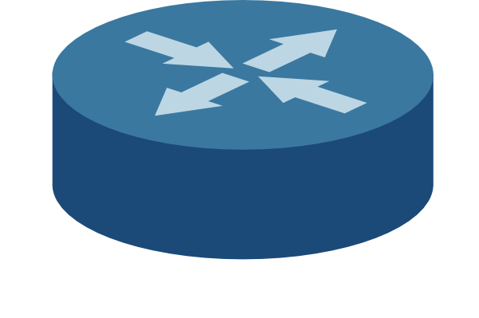
ARP (Across local networks)
Destination is NOT in same local network
How can we tell?
Use subnet mask to check dest network address
ARP Table
IP Addr. | Ethernet Addr.
d.c.b.a | 50:11:11:11:11:11
d.c.b.c | 60:37:11:11:11:11
Src’s First Hop Router
IP: d.c.b.a
Ethernet address: 50:11:11:11:11:11
Dest Host
IP: a.b.c.d
Ethernet address: 40:11:11:11:11:11
Local Network 1
Router 2
Local Network 2
Src Host

Slide 53
ARP (Across local networks)
Use ARP table to lookup Ethernet address of first-hop-router (which is in same local network)
We know router’s IP address through DHCP!
Specify first-hop router’s Ethernet address in packet and send packet
ARP Table
IP Addr. | Ethernet Addr.
d.c.b.a | 50:11:11:11:11:11
d.c.b.c | 60:37:11:11:11:11
Src’s First Hop Router
IP: d.c.b.a
Ethernet address: 50:11:11:11:11:11
Dest Host
IP: a.b.c.d
Ethernet address: 40:11:11:11:11:11
Local Network 1
Router 2
Local Network 2
Src Host

Slide 54
ARP (Across local networks)
First-hop router will route packet to router 2 using dest IP address
Dest IP address is a.b.c.d. in this example
ARP Table
IP Addr. | Ethernet Addr.
d.c.b.a | 50:11:11:11:11:11
d.c.b.c | 60:37:11:11:11:11
Src’s First Hop Router
IP: d.c.b.a
Ethernet address: 50:11:11:11:11:11
Dest Host
IP: a.b.c.d
Ethernet address: 40:11:11:11:11:11
Local Network 1
Router 2
Local Network 2
Src Host

Slide 55
ARP (Across local networks)
Router 2 will use its ARP table to set packet’s dest Ethernet address to actual dest host’s Ethernet address:
Router 2 then sends packet to dest host
ARP Table
IP Addr. | Ethernet Addr.
a.b.c.d | 40:11:11:11:11:11
a.b.c.c | 70:33:33:33:11:11
ARP Table
IP Addr. | Ethernet Addr.
d.c.b.a | 50:11:11:11:11:11
d.c.b.c | 60:37:11:11:11:11
Src’s First Hop Router
IP: d.c.b.a
Ethernet address: 50:11:11:11:11:11
Dest Host
IP: a.b.c.d
Ethernet address: 40:11:11:11:11:11
Local Network 1
Router 2
Local Network 2
Src Host

Slide 56
Host Networking

Slide 57
What is Host Networking?
Everything at the host that enables it to use the network
Linux networking stack, network driver, NIC, etc…
Sender Application
Host Networking Stack
Network Interface Card

Slide 58
Advanced Host Networking
Datacenter operators have the incentive to put a lot of effort into optimization
And have the means: total administrative control
Some opportunities for optimization
Kernel bypass (avoid kernel development)
NIC offloads (save CPU cycles)
RDMA (save CPU cycles, and better performance)
Other features (better performance)
Congestion control
Load balancing
Traffic shaping
QoS

Slide 59
Kernel Bypass
Run networking stack in user space rather than kernel space
App
Shared Memory
Data
Data
OS
NIC
Data
App
User-Space Process
Data
vs
Data
OS
Data
NIC
Data

Slide 60
NIC Offloads
What is offloading?
Implementing some tasks in hardware to free up CPU cycles
In our case, putting some networking tasks in the NIC instead of the kernel
Why offload?
Save CPU cycles
Performance gains

Slide 61
NIC Offloads
Range from simple (checksum computation) to advanced (protocol offload)
Checksum
Match-Action
← Simple Complex →
Segmentation
Protocol Offload

Slide 62

RDMA
Remote Direct Memory Access
Removes CPU from transfers (almost entirely)
Sender
Receiver
CPU
cores
CPU
cores
Host memory
Host memory
NIC
Without RDMA
NIC

Slide 63
RDMA
Remote Direct Memory Access
Removes CPU from transfers (almost entirely)
Sender
Receiver
CPU
cores
CPU
cores
Host memory
Host memory
NIC
NIC
With RDMA

Slide 64
RDMA - How?
Queue pairs
Send and receive queues with Work Queue Elements (WQEs) in them
WQEs
Pointer to memory to transfer / receive data in
Completion Queue and Completion Queue Elements (CQEs)
Signals about whether transfers have completed or not
Send Work Queue
Receive Work Queue
Completion Queue
RDMA NIC

Slide 65
Advanced Features - Congestion Control
Problem:
TCP is buffer-filling
Loss is a coarse signal
Solution: use delay as a signal
Challenging to get a correct measurement
Why is this approach better in a DC?
Note: this is not the only way to do advanced CC
Very active area of research!
if RTT < Target
increase cwnd
(Additively)
else
decrease cwnd
(Multiplicatively)

Slide 66
Advanced Features - Load Balancing
Problem: ECMP can have collisions that cause hotspots
Solution: repath based on congestion signals
Note: ECMP could place it badly again – repeat as necessary

Slide 67
Advanced Features - Traffic Shaping
Problem: Need to share bandwidth according to policy
Note: congestion control alone cannot do this
Solution:
Classify traffic and rate limit it
Use a time wheel because managing multiple queues is difficult
Socket Buffers
To NIC
Timestamper
Shaper

Slide 68
Advanced Features - QoS
Problem: Need a way to express how much of a resource a flow should get
Solution: priority classes and enforcement in the queue
Senders
Switch
Egress Link
Receiver
1: buffer allocation
2: bandwidth allocation
QoS
weight
hi
4
bandwidth
Packets in time slots in Egress Link
mid
2
lo
1

Slide 69
Traffic Shaping vs QoS
Traffic Shaping:
Occurs at the host
Specifies the amount of bandwidth each type of traffic receives
QoS (Quality of Service):
Only comes into play when link is at max capacity
When there is contention on resources, assigns priority to offload packets from the queue based on the class it belongs to

Slide 70
Wireless + Cellular

Slide 71

What is wireless communication?
Transmit information without contact (e.g. with EM waves)

Slide 72
How is wireless different from wired?
Wireless …
is a fundamentally shared medium
signals attenuate significantly with distance
environments can change rapidly
packet collisions are hard to detect

Slide 73
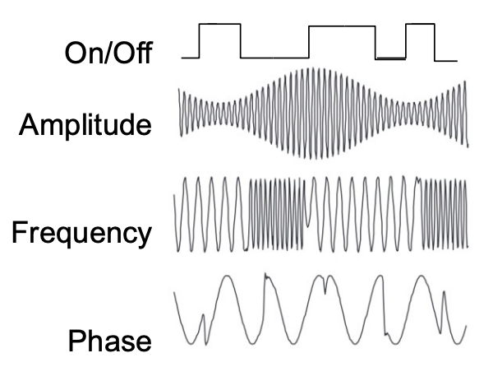
How is data encoded?
Physical Layer Modulation: Physical variations in signals map to digital values (i.e. 1 or 0)

Slide 74

The wireless medium is messy
Details out of scope!! Check out EE117, EE 121, EE122

Slide 75
Medium Access Control

Slide 76

How to share the same transmission technology?
Key problem: wireless collisions are often unexpected (highly mobile, dynamic environment) and hard to detect (failure is the only indication)
Solution: CSMA

Slide 77
Carrier Sense Multiple Access (CSMA)
Key idea: listen for others on the medium and don’t transmit if busy
Works great when ranges of involved transmitters/receivers are all overlapping or completely disconnected
R1
R2
D
A
E
C
B

Slide 78
Hidden Terminal Problem
A problem: two transmitters can’t hear each other
D
C
R

Slide 79
Exposed Terminal Problem
Another problem: ‘safe’ transmissions could be blocked since D and C hear each other transmitting
D
C
R1
R2

Slide 80
Request to Send / Clear to Send (RTS/CTS)
Key idea: send a request-to-send and wait for a clear-to-send before transmitting
D
C
R
RTS, D: k bits
CTS, D: k bits
CTS, D: k bits
D sends k bits

Slide 81
Multiple Access with Collision Avoidance for Wireless (MACAW)
D
C
R1
R2
Key idea: Use RTS/CTS, but add backoff to deal with RTS collisions and reliability by using acks and a data sending indicator
RTS, D: k bits
RTS, D: k bits
C knows to wait!
CTS, D: k bits
D is DS packet
D is DS packet
D sends k bits
D sends k bits
R1 sends ACK

Slide 82
WiFi

Slide 83

How does WiFi (802.11) work?
Internet
Designed for a limited area (i.e. home)
Access points (APs) set to a channel
APs broadcast beacon messages with SSID (Service Set Identifier) and MAC Address periodically
Hosts scan all channels to discover APs
Hosts associate with AP
AP1
Router
AP1

Slide 84
How does WiFi (802.11) work?
Essentially uses CSMA (this is over simplified but details are out of scope)
RTS/CTS is an optional feature (mainly used for large data transfers)
Why would WiFi not use a full MACAW protocol all the time?

Slide 85
Cellular

Slide 86
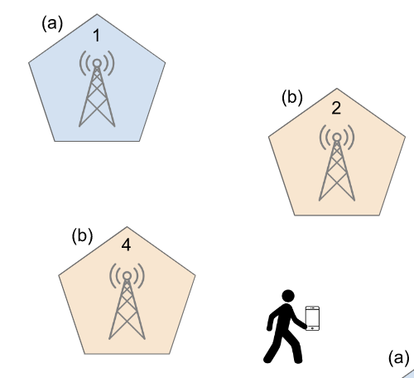
How does cellular work?
Key goal: Mobility
Authentication and accountability are also first order goals
Two Major Components:
Cellular RAN: between devices and cell towers
Cellular Core: between gateways and internet

Slide 87
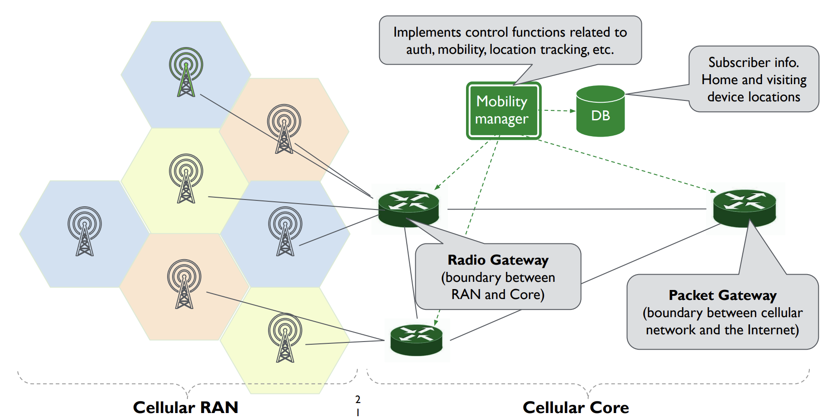
How does cellular work?

Slide 88
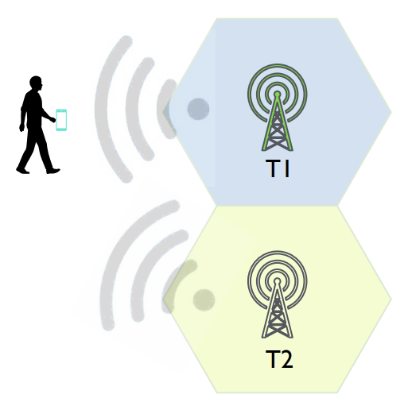
Discovery
Towers transmit periodic “beacons” which ID the operator
Device picks the best tower based on signal strength

Slide 89
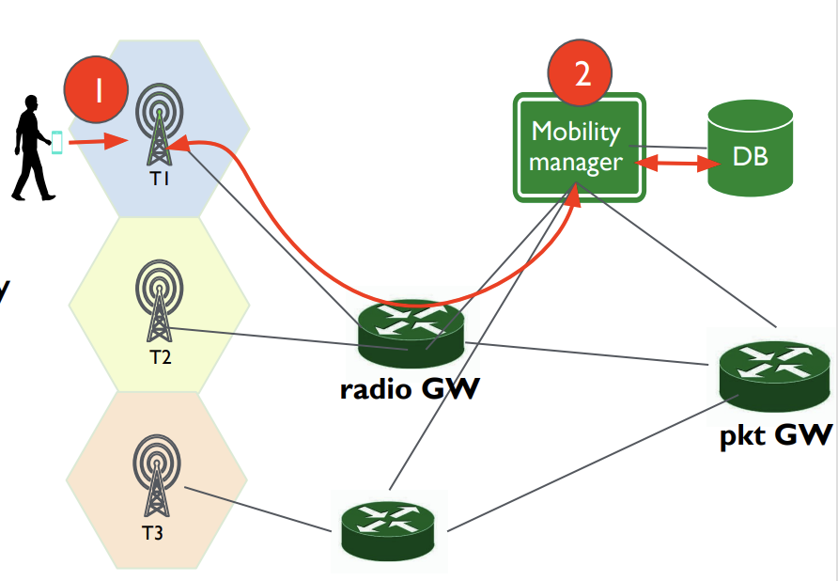
Attachment
Device sends “attach request” to tower with best signal strength owned by operator.
Request is processed/authenticated by the mobility manager

Slide 90
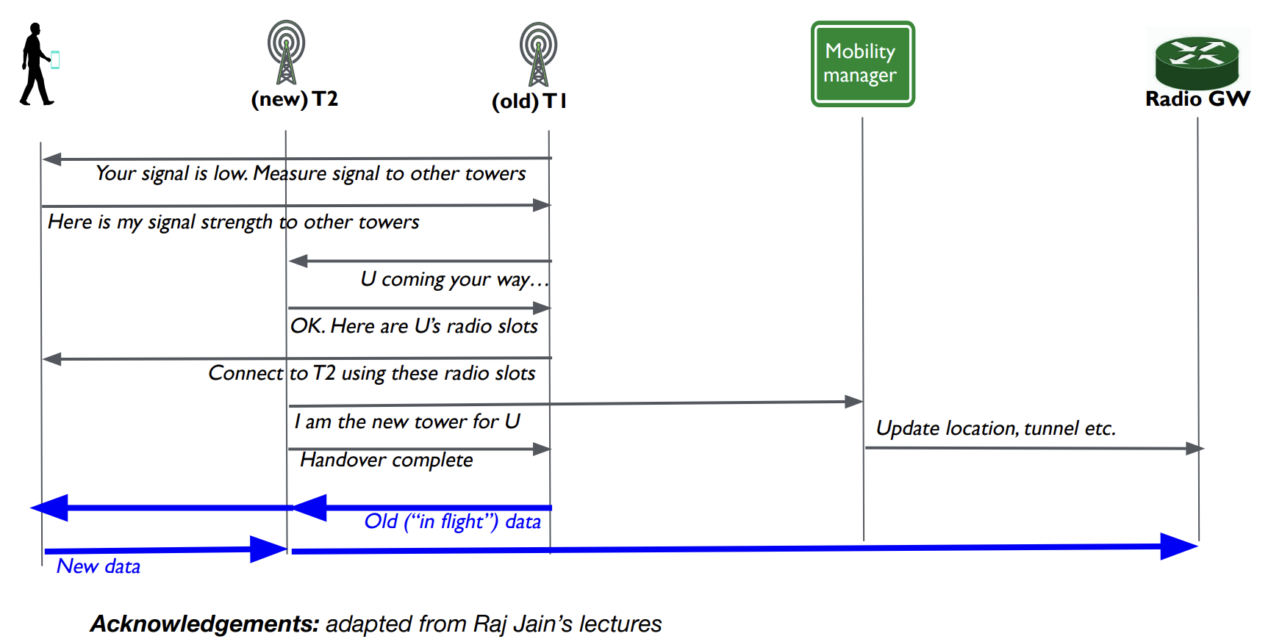
Handover
Cooperatively done between U,T1,T2,mobility manager, radio gateway

Slide 91
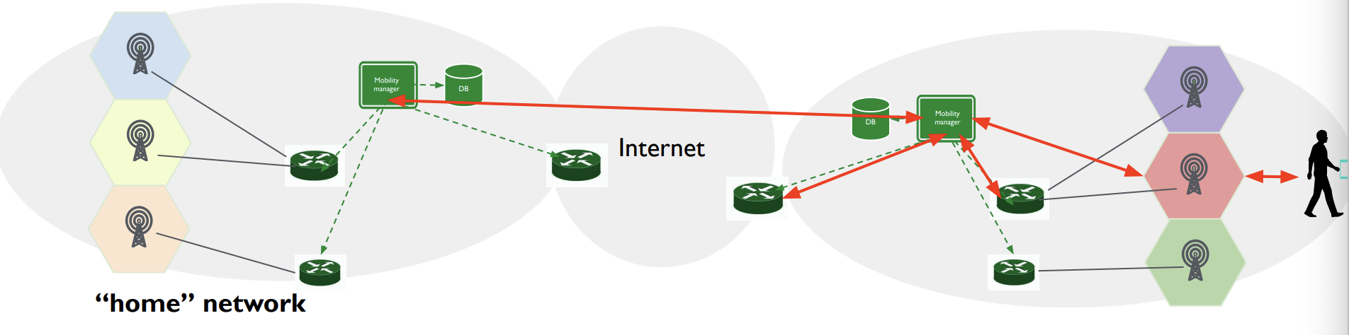
Roaming
Mobility manager in the “visited” network has to check with the “home” network mobility manager for authentication.
Can either route data through home network packet gateway or visited network packet gateway

Slide 92
Practice Exam Questions

